Slide 1
Snowflake

Slide 2
Snowflake: What, Why, and How

Slide 3
Snowflake is a cloud-native data platform (Data Warehouse + Data Lake + Data Sharing)
It runs on AWS, Azure, and GCP → fully managed SaaS.
Key features:
Separation of storage & compute (elastic scaling).
Supports structured & semi-structured data (JSON, Avro, Parquet, XML).
Built-in data sharing & collaboration.
Pay-as-you-go model.

Slide 4
Why Snowflake?
Scalability: Instantly scale up/down compute without affecting storage.
Performance: Automatic optimization with micro-partitions & caching.
Concurrency: Multiple teams (ETL, BI, ML) can query the same data simultaneously without bottlenecks.
Multi-cloud: Runs on AWS, Azure, and GCP → avoids vendor lock-in.
Semi-structured data: Handles JSON/Parquet like SQL tables.
Cost efficiency: Pay separately for compute (per-second) & storage.
Zero management: No DBA tasks like indexing, tuning, patching.
Secure data sharing: Share live data with partners/customers across regions/clouds without copying.

Slide 5
How Snowflake Works
Storage Layer
Data stored in compressed, encrypted micro-partitions.
Centralized storage (independent of compute).
Compute Layer (Virtual Warehouses):
Independent compute clusters that access the same storage.
You can spin up multiple warehouses for different workloads (ETL, BI, ML).
Scale up (bigger compute) or scale out (more clusters).
Cloud Services Layer:
Manages metadata, security, query optimization, and transactions.
Handles authentication, monitoring, access control.

Slide 6
Workflow Example
Load Data
Ingest raw data from S3, Azure Blob, GCP Storage, Kafka, or APIs.
Transform Data
Use SQL (or dbt, Spark, Airflow) to clean, join, and process data.
Query & Analyze
BI tools (Tableau, Power BI, Looker) or ML frameworks connect directly.
Share & Collaborate
Share real-time data securely across regions/clouds.

Slide 7
What: Cloud-native data warehouse platform.
Why: Scalable, cost-efficient, multi-cloud, minimal management.
How: Separation of compute & storage + multi-cluster architecture.

Slide 8
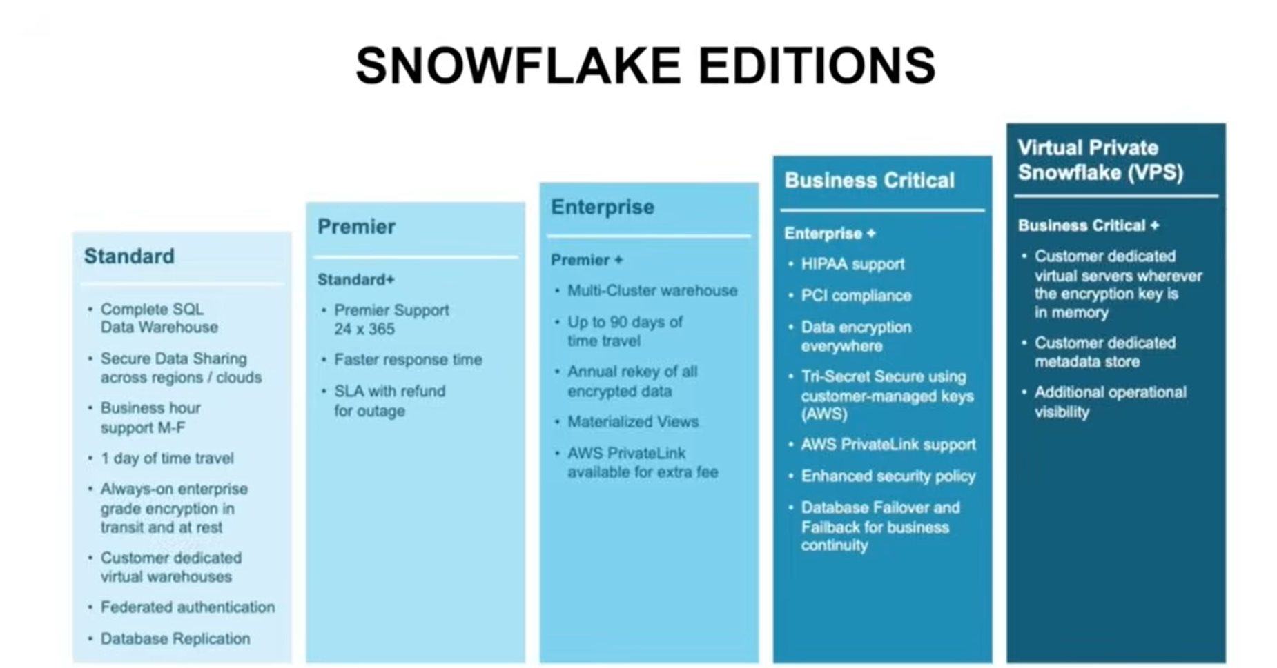

Slide 9
Snowflake Architecture

Slide 10
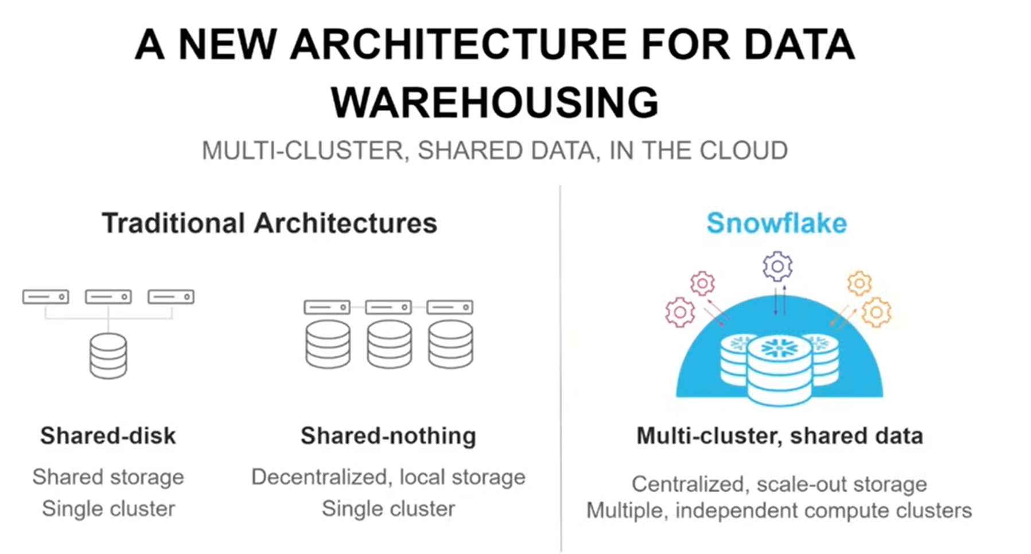

Slide 11
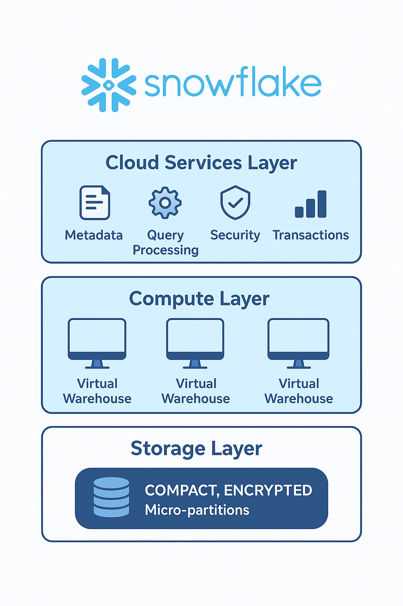

Slide 12
Snowflake has a 3-layer architecture:
1. Storage Layer
2. Compute Layer (Virtual Warehouses)
3. Cloud Services Layer

Slide 13
1. Storage Layer
Data is stored in compressed, encrypted micro-partitions (immutable files).
Centralized storage, completely separated from compute.
Can store both:
Structured data (tables, rows, columns).
Semi-structured data (JSON, Avro, Parquet, ORC, XML) inside a VARIANT type.
Managed automatically → no manual indexing, vacuuming, or distribution keys.

Slide 14
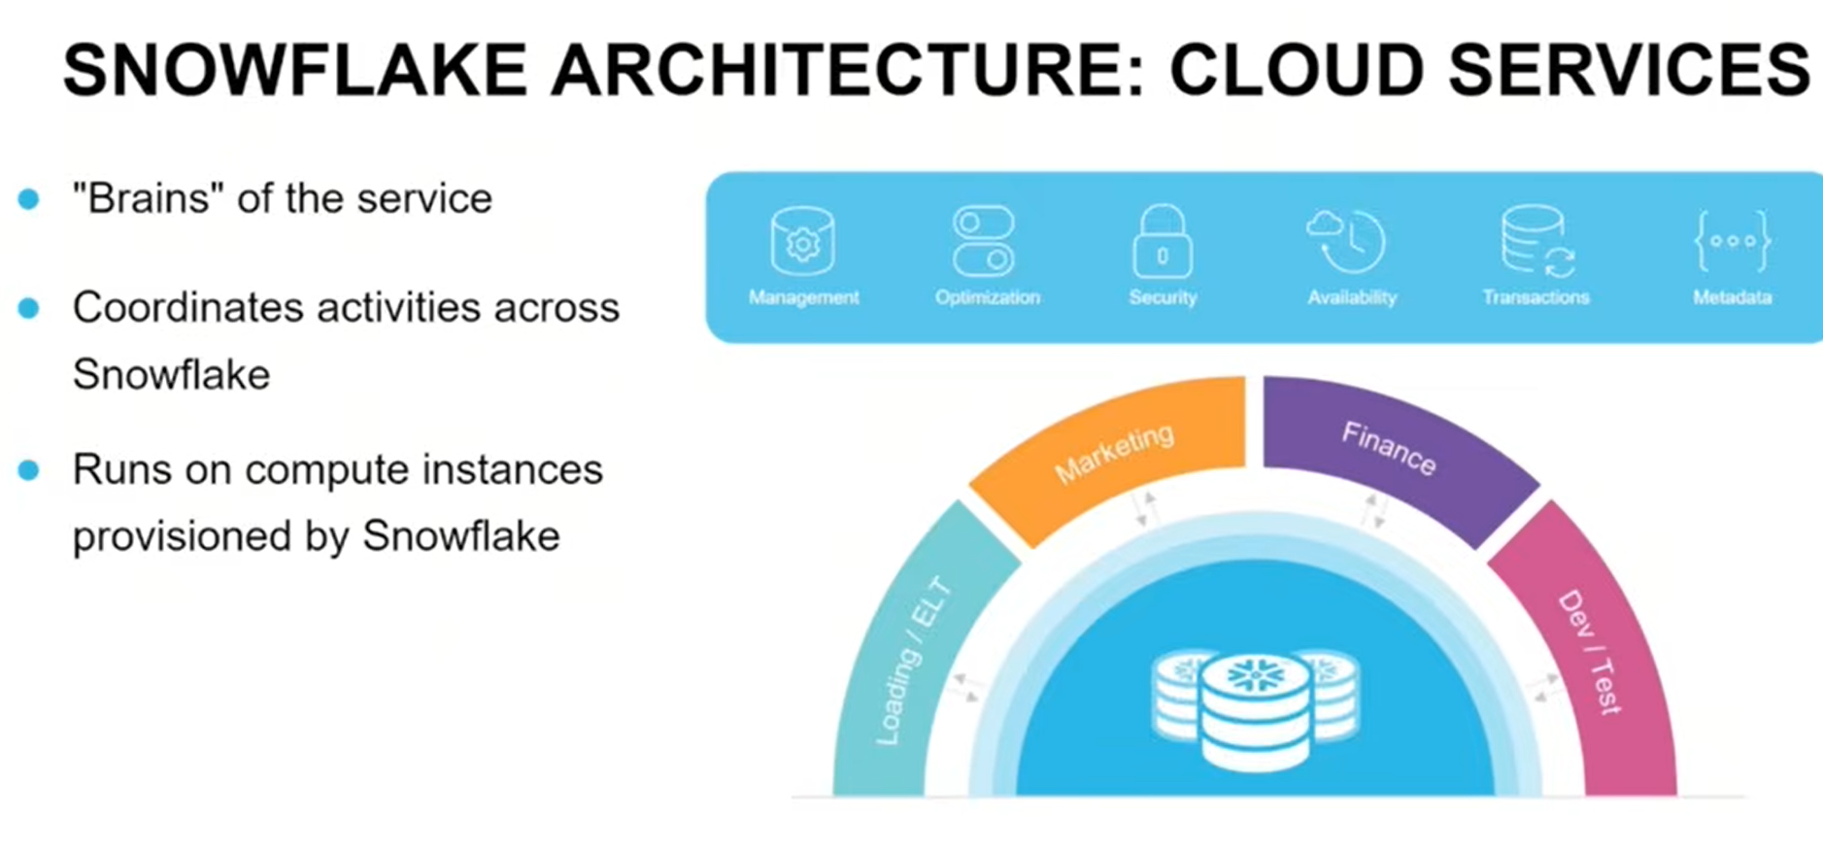

Slide 15
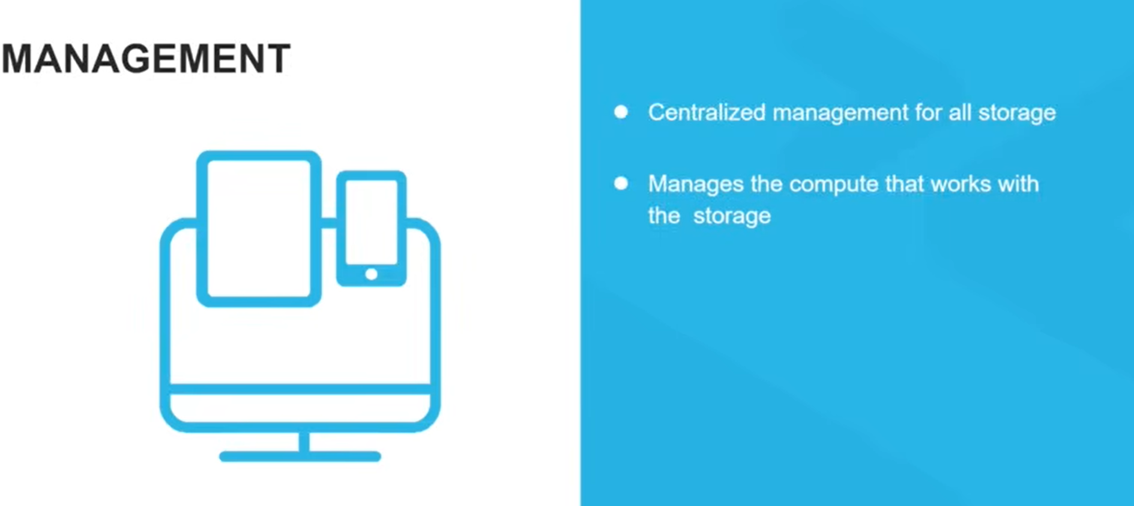
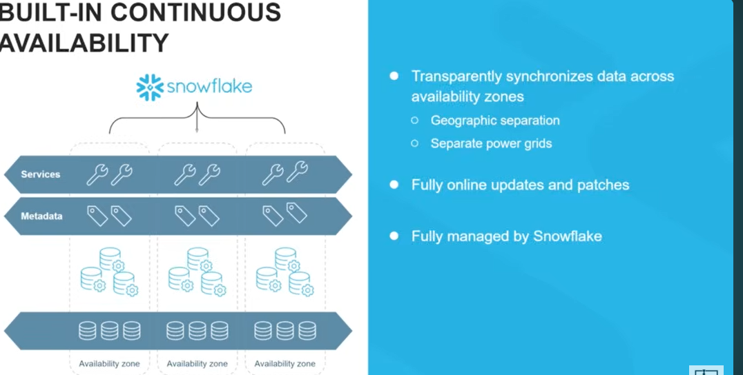

Slide 16
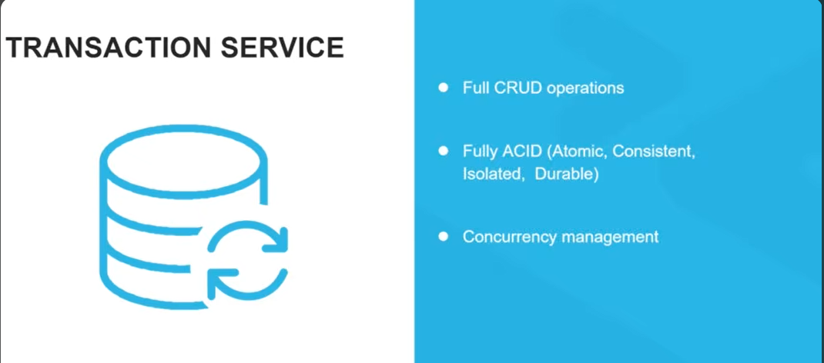
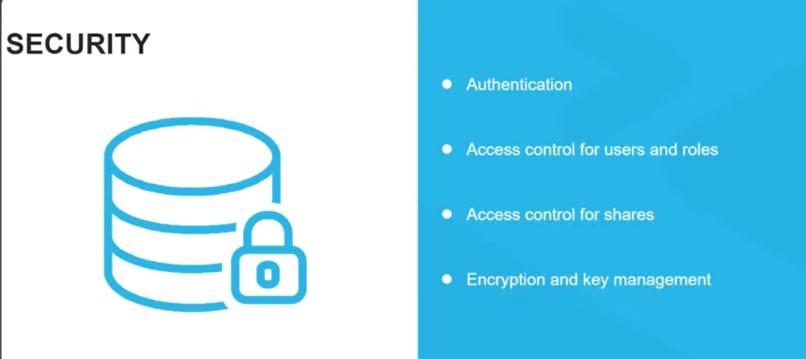

Slide 17
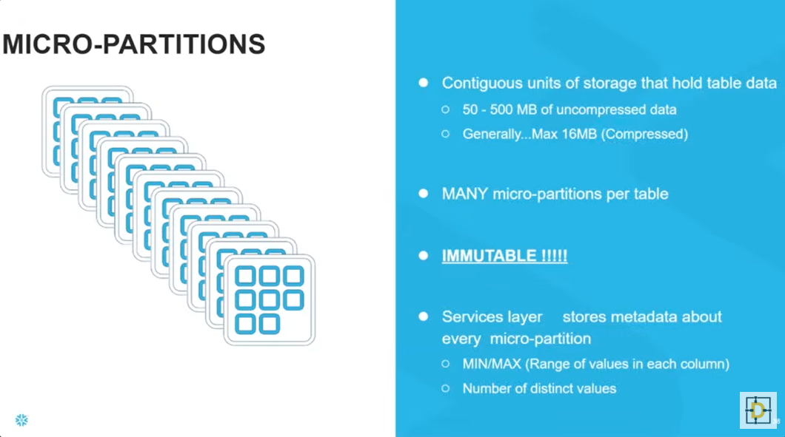

Slide 18
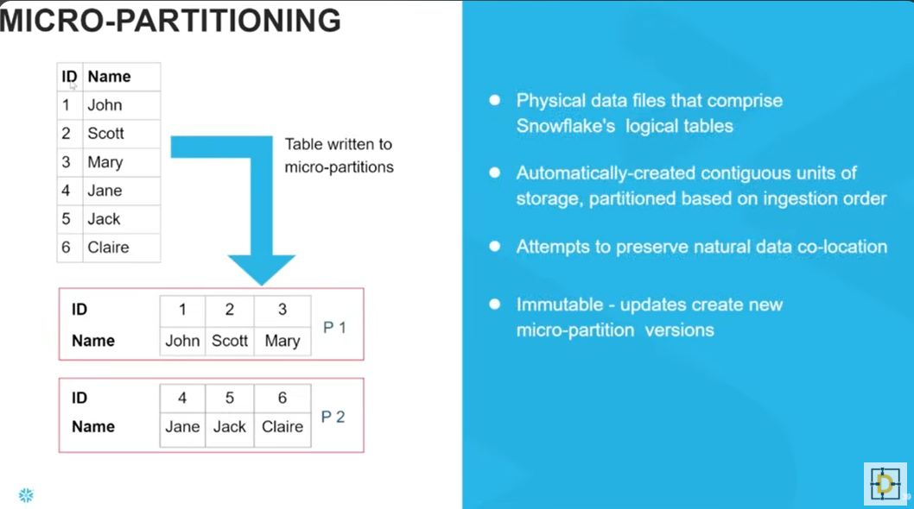

Slide 19
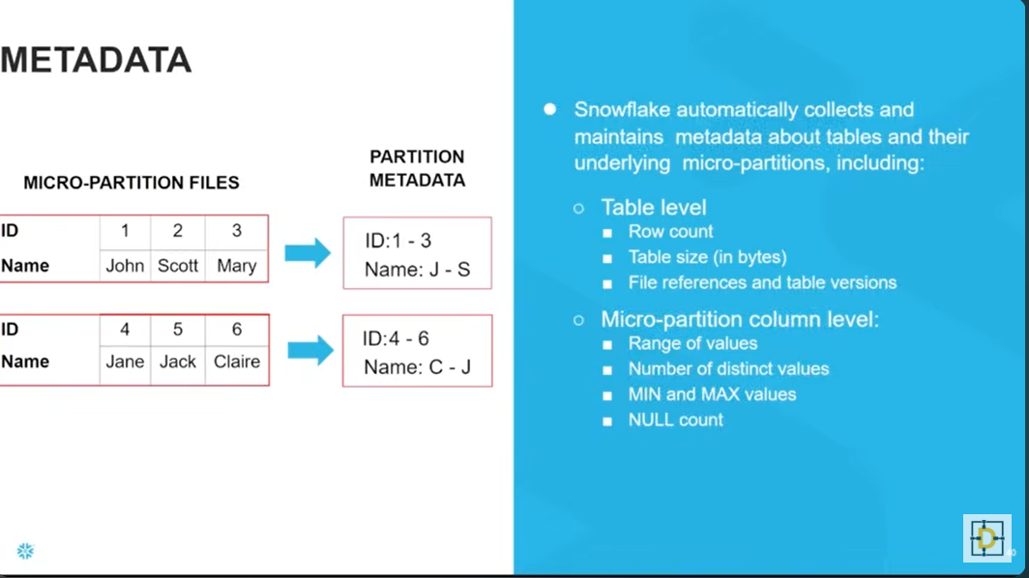

Slide 20
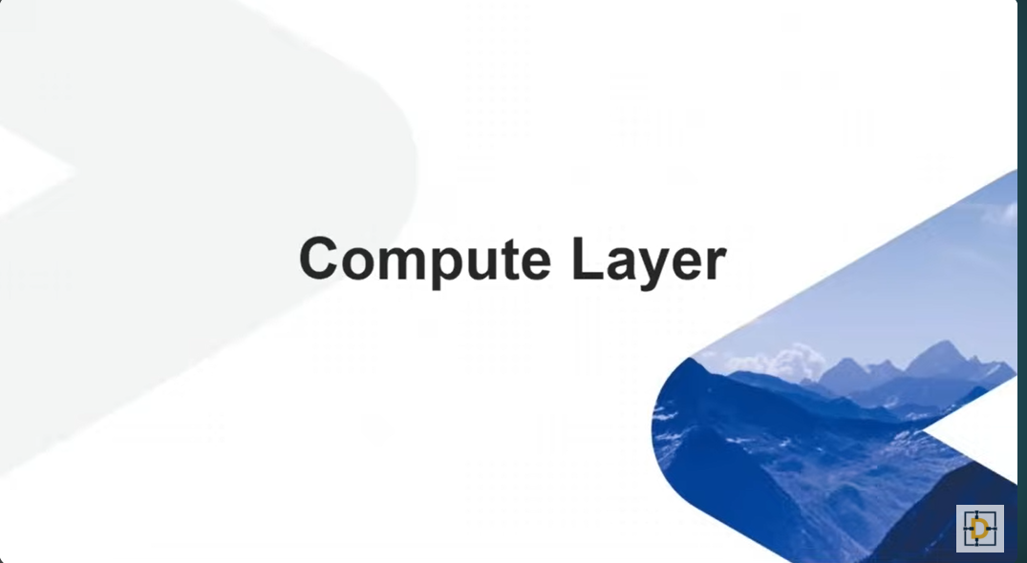

Slide 21
Compute Layer (Virtual Warehouses)
Independent compute clusters that process queries.
​In Snowflake, a Virtual Warehouse is an independent cluster of compute resources (MPP - Massively Parallel Processing) that performs your queries. It's dedicated hardware on demand, meaning it only runs when you need it and scales effortlessly.
Each warehouse can:
Be resized (scale up for heavy workloads).
can run independently without affecting others.
Auto-scale (add clusters during peak usage).
Run in parallel (no resource contention).
Multiple warehouses can query the same storage at the same time:
Example: ETL job, BI dashboards, and Data Science models all run independently.

Slide 22
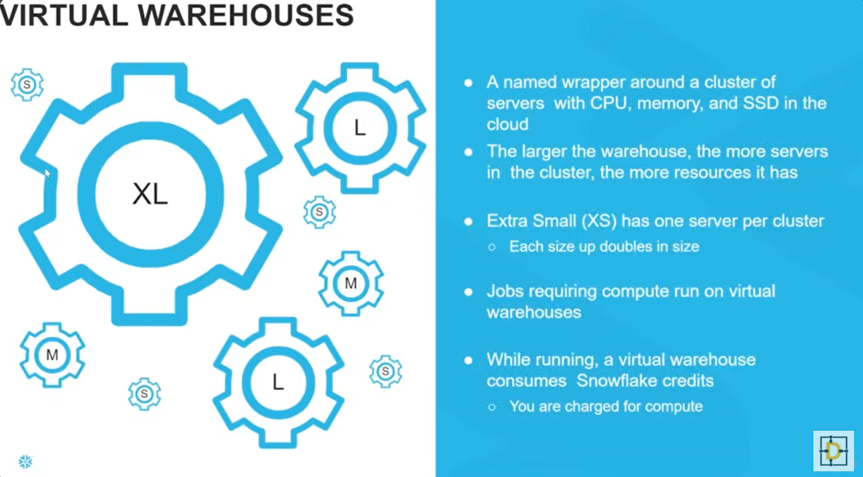

Slide 23
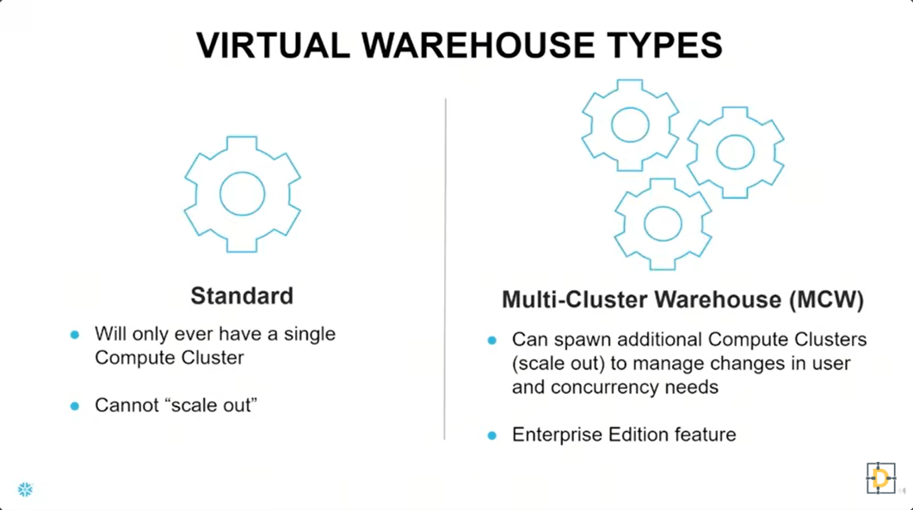

Slide 24
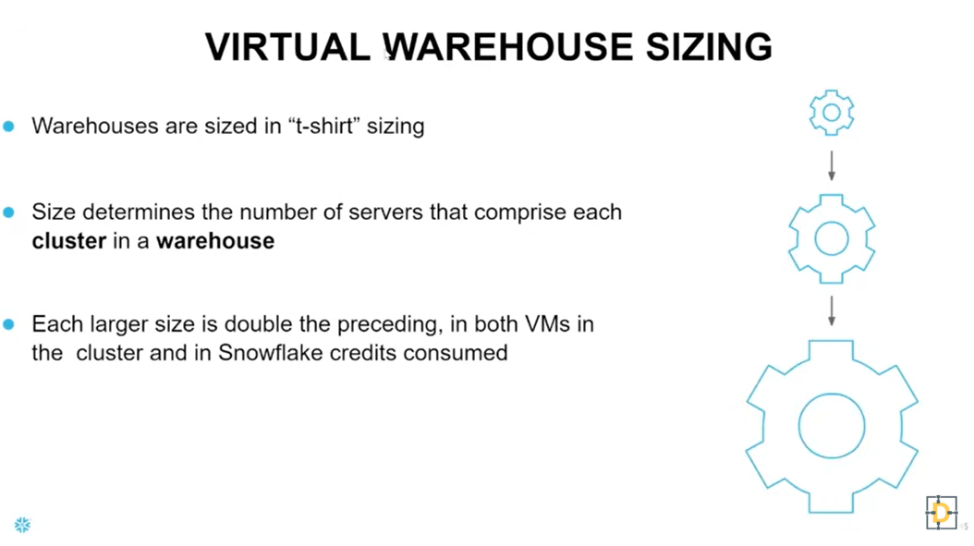

Slide 25
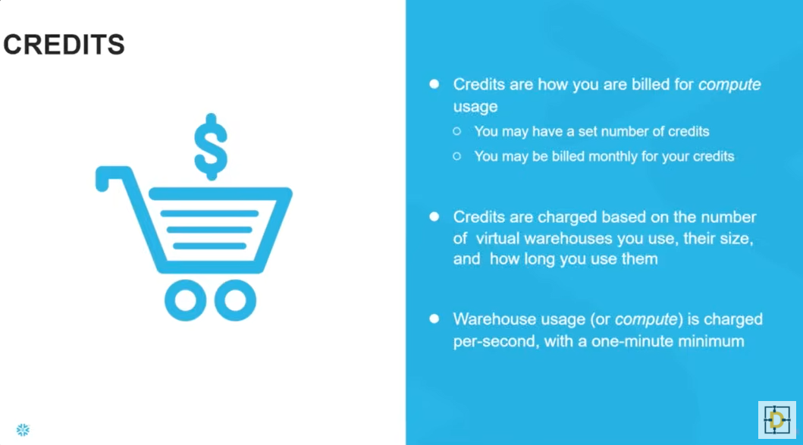

Slide 26
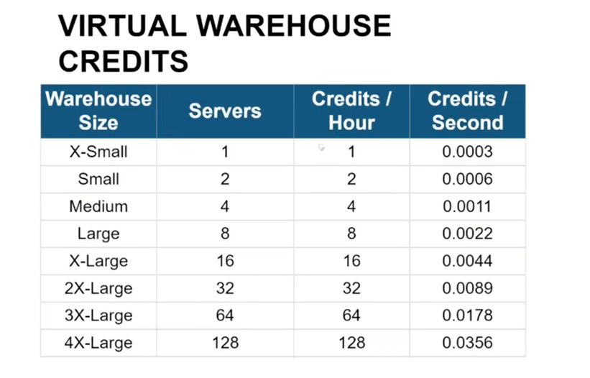

Slide 27
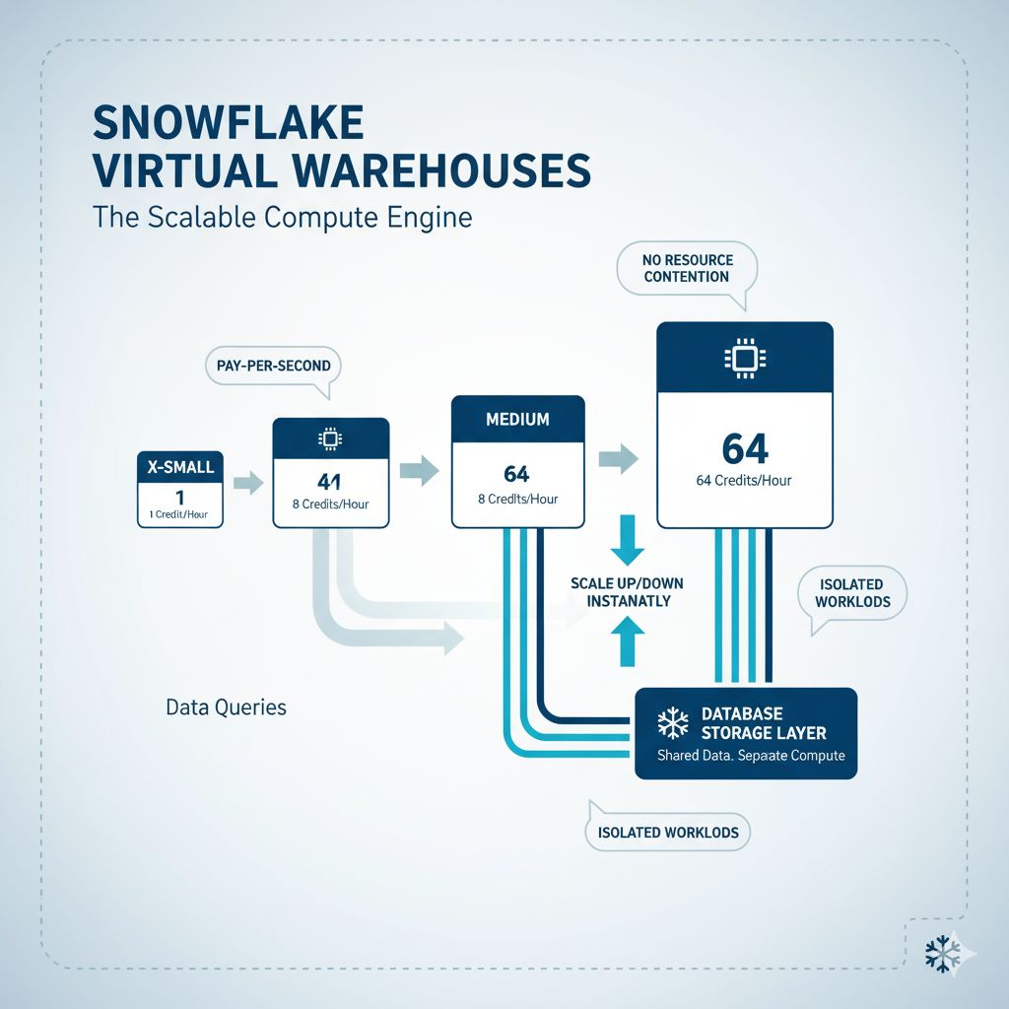

Slide 28
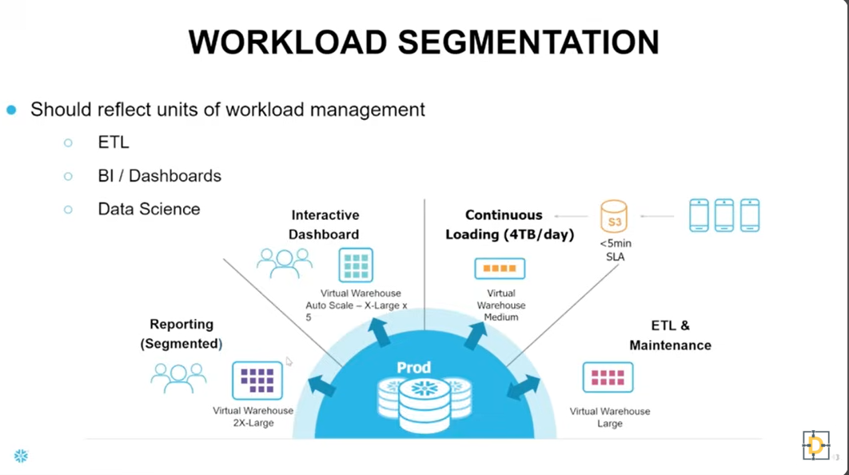

Slide 29
Cloud Services Layer

Slide 30
Coordinates everything & The brain of Snowflake architecture.
Manages query optimization, metadata(schemas, tables, partitions), security, and authentication.
Ensures automatic scaling, concurrency handling, and data sharing.
Features like automatic query optimization and time travel come from this layer.
Security & access control.
Transactions (ACID compliance).
This is what makes Snowflake serverless-like (you don’t manage infra).
Snowflake’s architecture = Centralized Storage + Independent Compute Warehouses + Intelligent Cloud Services.

Slide 31
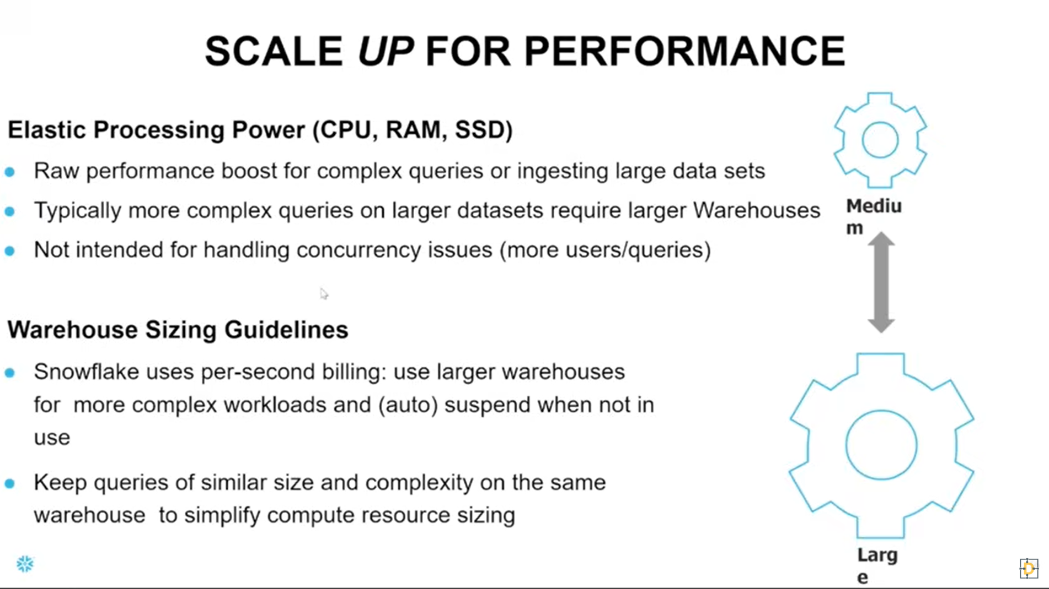

Slide 32
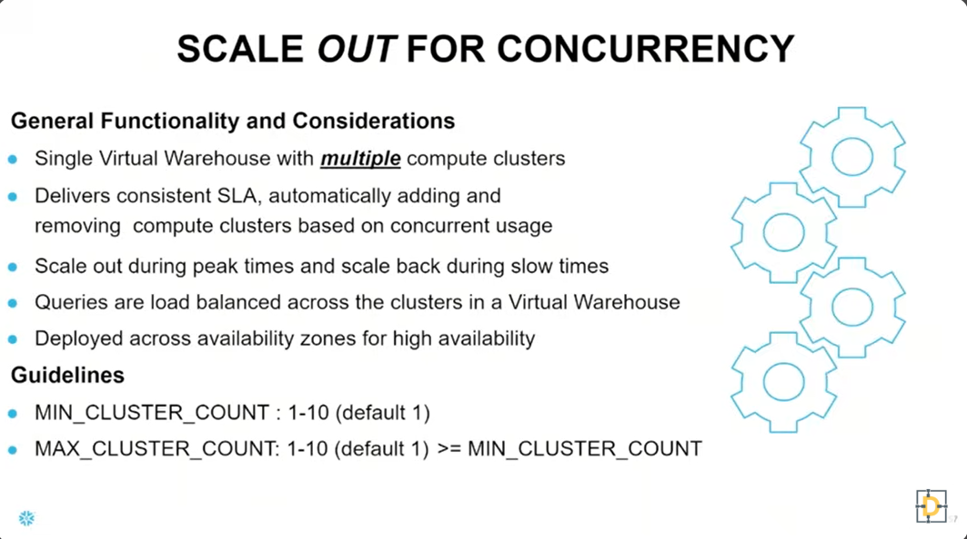

Slide 33
Key Benefits of This Architecture
Separation of compute & storage → elastic scaling.
Unlimited concurrency → multiple teams work simultaneously.
Multi-cloud deployment → AWS, Azure, GCP.
Automatic optimization → no DBA overhead.
Built-in security & governance → role-based access, encryption, auditing.

